Slide 1
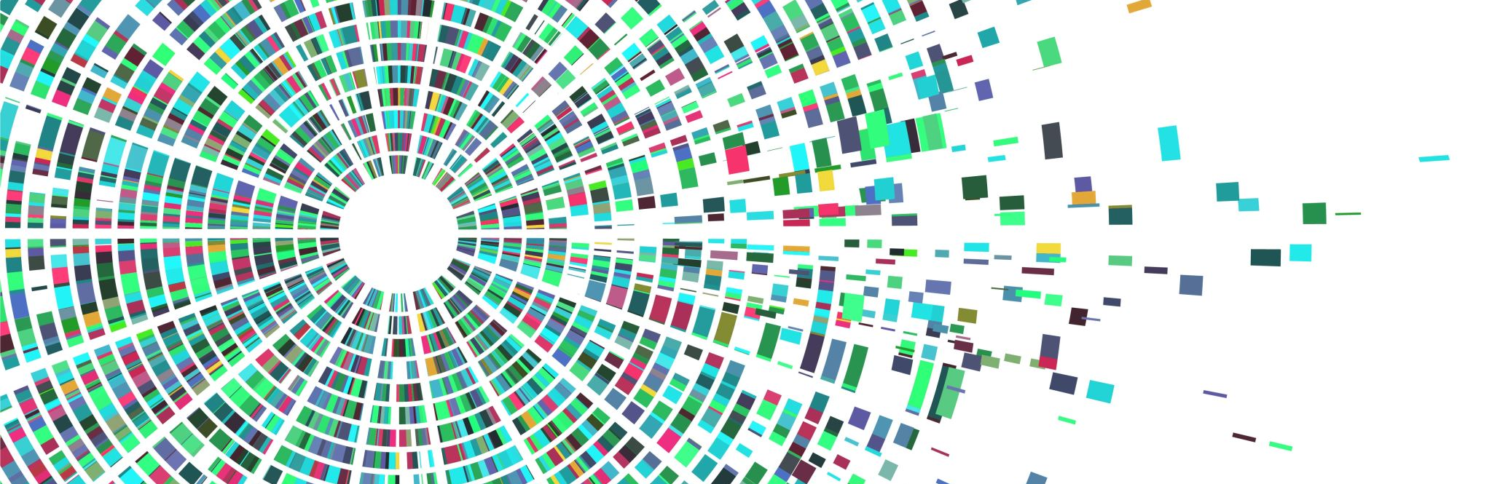
Symposium progress presentation
Frank van der Velde
Team 8
17 October 2025

Slide 2
Agenda
Introduction
Research question
Method
Model
Datasets
Preliminary results
Discussion

Slide 3
Introduction
Why this research
Hypothesis
Types of occlusions
Color
Texture
Brightness
Altering landmarks

Slide 4
Research question
“The Impact of Makeup on Age Estimation Models AcrossEveryday, Synthetic, and Extreme Conditions”

Slide 5
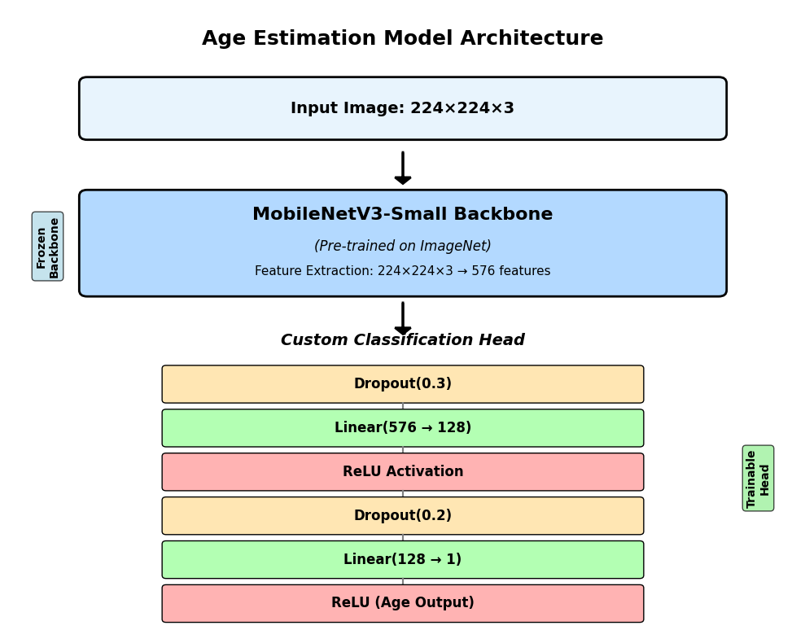
Method - Model
MobileNetV3-small
Lightweight model
Fine tuned for age regression
Lightweight & Fast
UTKFace
Populair
Often cited
Performance metric MAE
MAE: 5.85

Slide 6
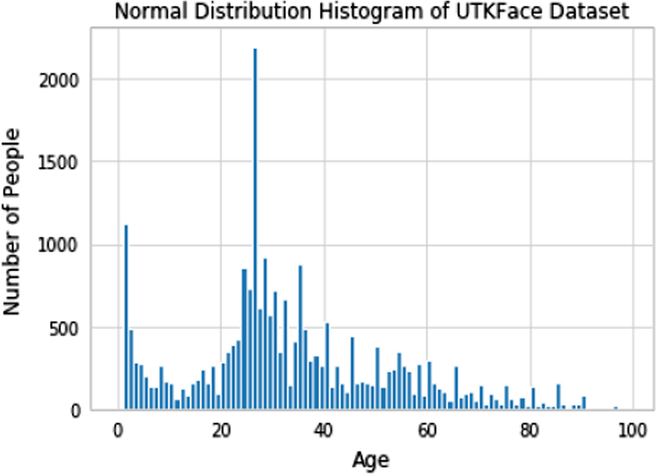
Method - Datasets
UTKFace
FFHQ Synthetic everyday makeup
Light makeup
Highlighting existing features
LADN Synthetic extreme makeup
Bright color changes
Hiding landmarks
Intense smoothing
Mini set natural makeup
Before & After
More noise

Slide 7

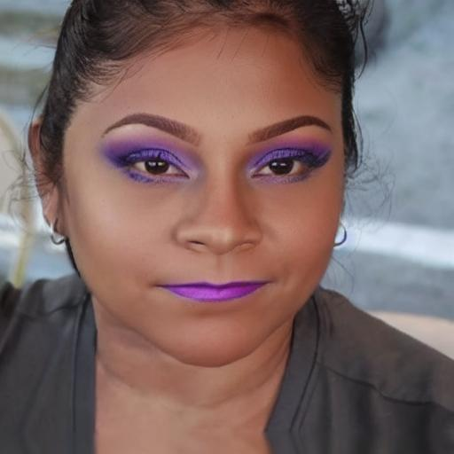
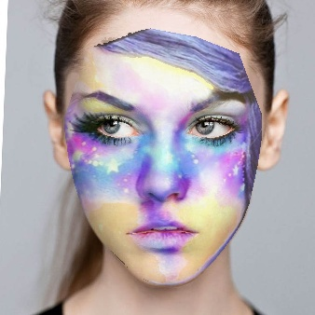
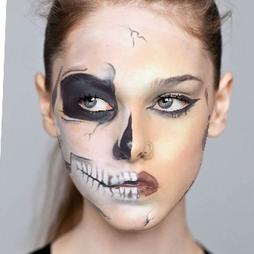
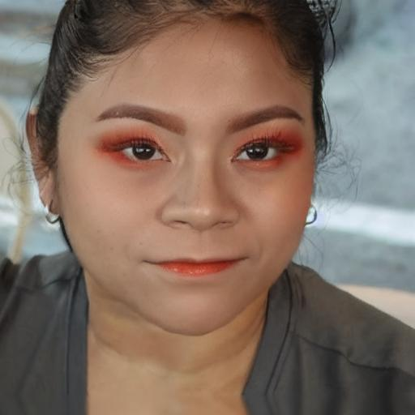
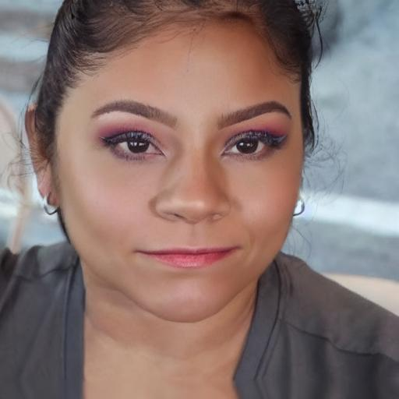
Methode – Data examples

Slide 8
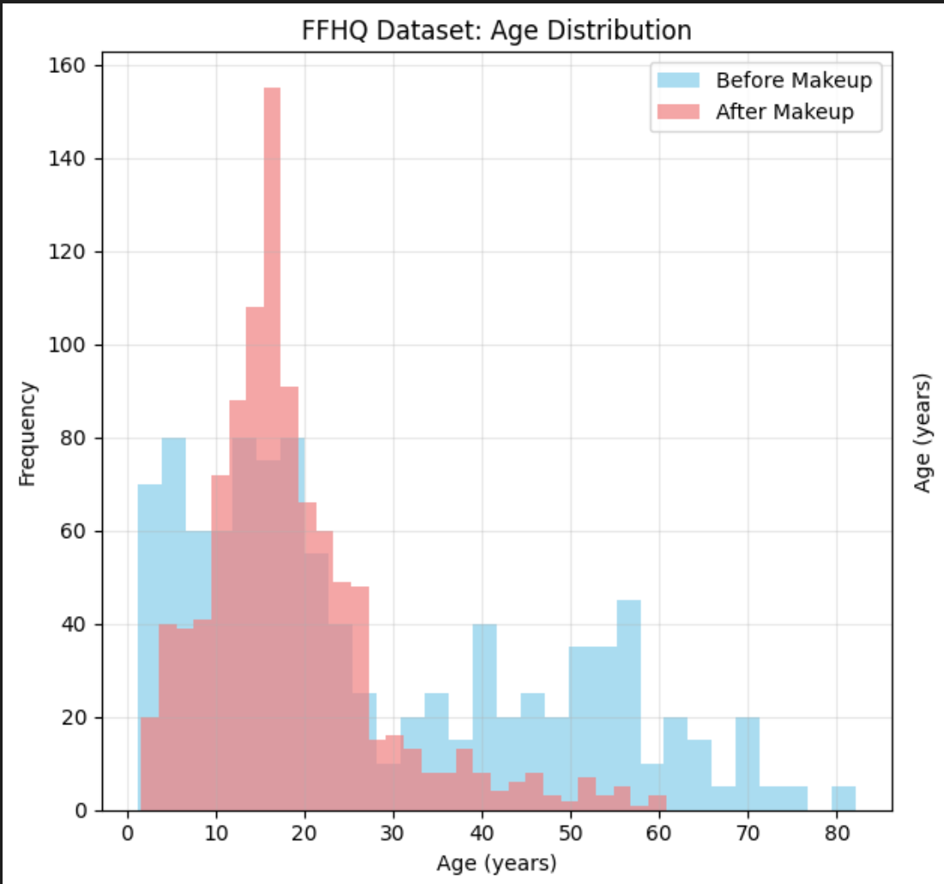
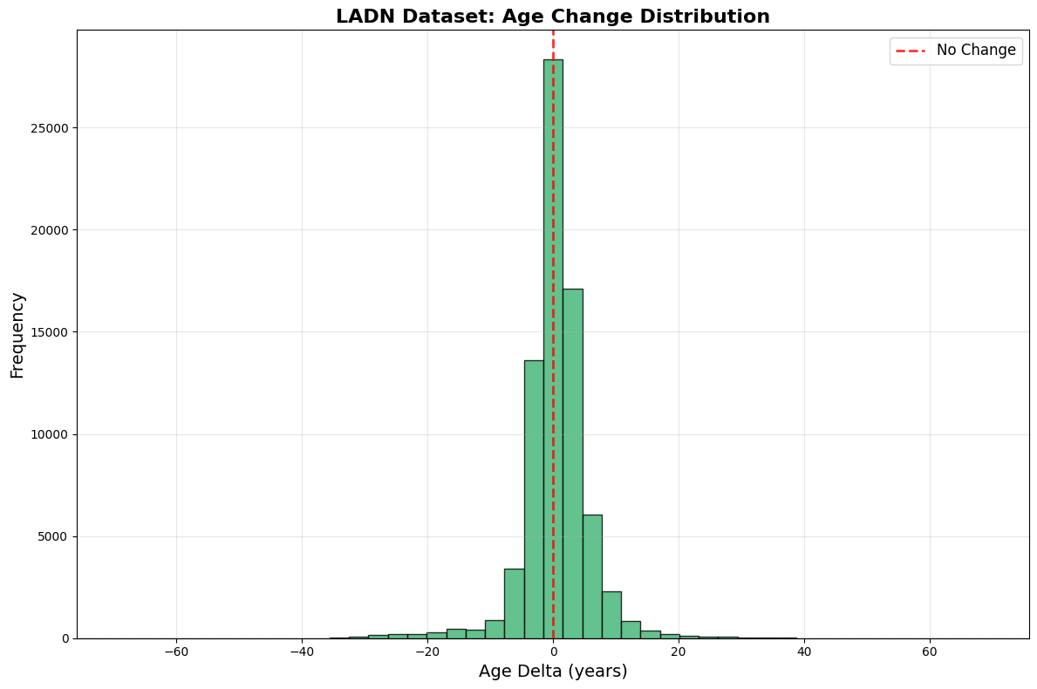
Preliminary results

Slide 9
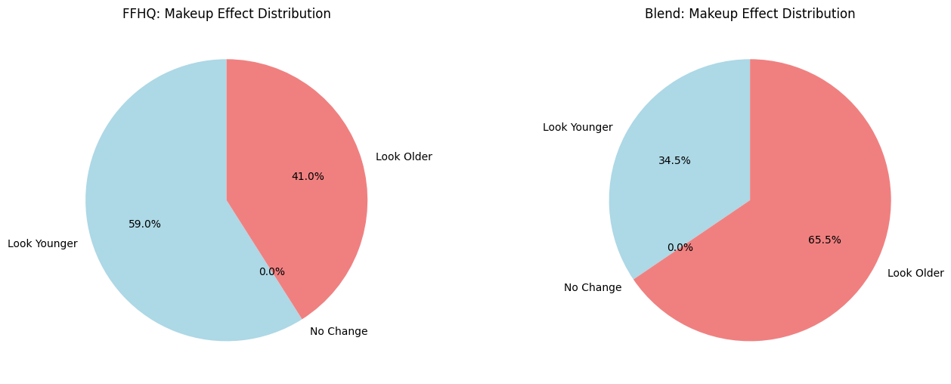

Slide 10
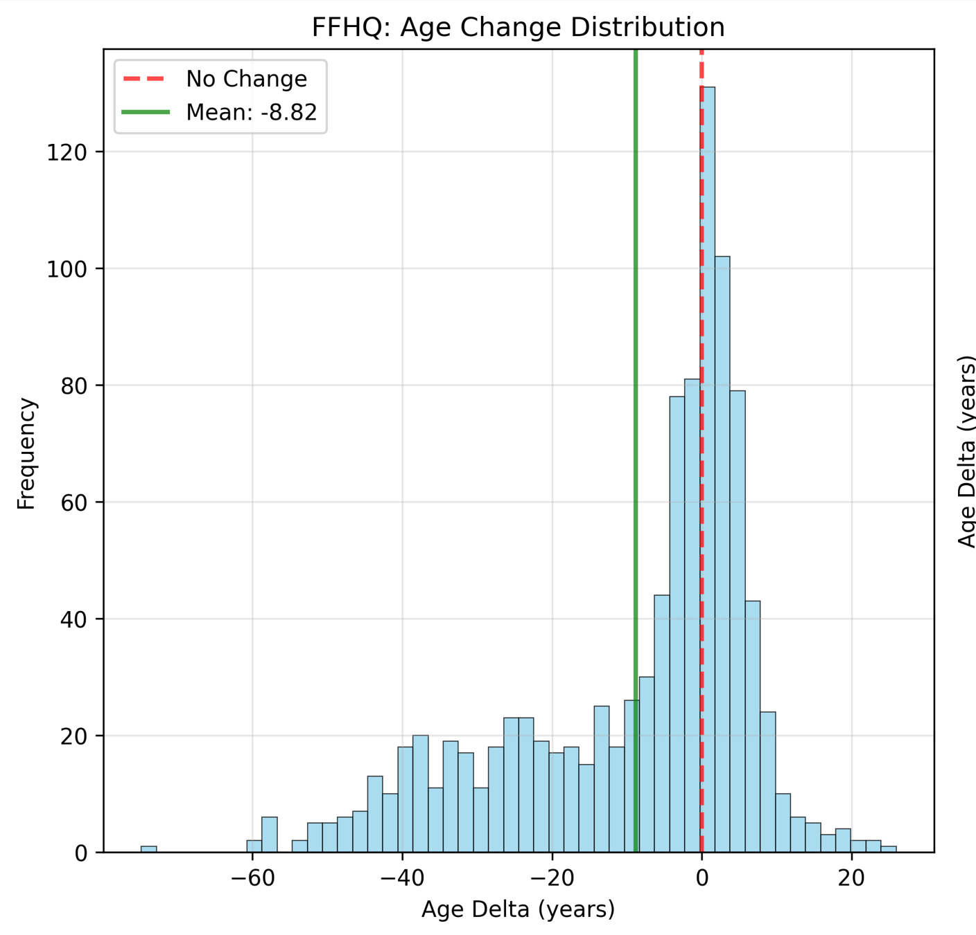
Statistical relevance
Model MAE 5.85
Mean change -8.82 for FFHQ

Slide 11
Discussion
Model choice?
Effect of primarily using synthetic data?
Possible directions for next few weeks?
Hand pick examples from the heavy makeupset for detailed analysis
Model heatmap
Comparison with human perception based on literature
Reconsidering model?
Finding more non synthetic data or removing this set

